Slide 1

Professional Practice CSE4007
GROUP PRESENTATION
Samarakoon Mudiyanselage Tharindu Francesco - CL/HDCSE/CMU/131/17 - st20339052 (Team leader)
Hingurage Ravindu Shenal Perera - CL/HDCSE/CMU/131/28 - st20338940 (Event vice president & Group Reporting Lead)
Dunukara Mudiyanselage Sithumi Amaya CL/HDCSE/CMU/131/14 st20339049 (Documentation)
Sahan Kavishka Adhikari CL/HDCSE/CMU/131/32 st20338943 (Corporate Relations Officer)
Randyn Shalinka Mario Uyanage CL/HDCSE/CMU/131/27 st20338939 (Corporate Relations Officer)

Slide 2
Assignment Cover Sheet
Qualification |  | Module Number and Title
HD in Computing and Software Engineering |  | Ethical, legal, and social issues arising from the use of emerging technology in all sorts of development projects/organizations CSE4007
Student Name & No. |  | Assessor
Randyn Shalinka Mario Uyanage CL/HDCSE/CMU/131/27 |  | Mr. Priyanga
Hand out date |  | Submission Date
2025-08-27 |  | 2025-11-16
Assessment type WRIT1 | Duration/Length of Assessment Type 3 weeks (3000 Words) | Weighting of Assessment 100%
Learner declaration
I, Randyn Shalinka Mario Uyanage CL/HDCSE/CMU/131/27- st20338939 , certify that the work submitted for this assignment is my own and research sources are fully acknowledged.
Marks Awarded
First assessor
IV marks
Agreed grade
Signature of the assessor |  | Date

Slide 3



Feedback Form
INTERNATIONAL COLLEGE OF BUSINESS & TECHNOLOGY
Module: Professional Practice
Student: Randyn Shalinka Mario Uyanage
Assessor: Mr. Priyanga
Assignment: Ethical, legal, and social issues arising from the use of emerging technology in all sorts of development projects/organizations
Strong
features of your work:
Areas for
improvement:
Marks Awarded:

Slide 4
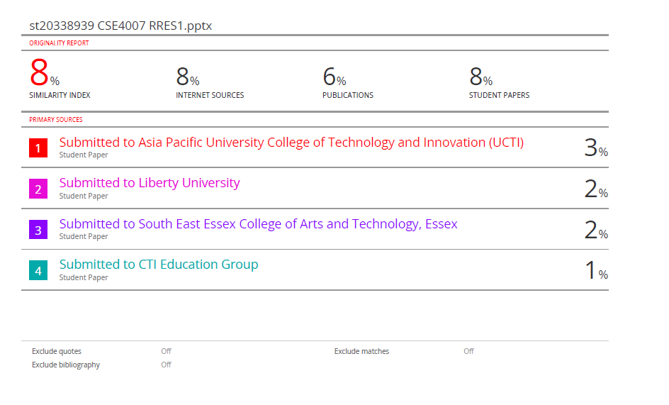

Slide 5
Acknowledgement
I would also wish to thank Mr.Priyanga whose guidance, support, and constructive criticisms helped in the successful completion of this work to the best of my knowledge. His teaching passion and devotion to serve the students has been an inspiration. I also wish to say my thanks to everyone who helped or assisted me, offered important point of view or helped by providing necessary materials during the process of the document creation.

Slide 6
Executive Summary
This paper summarizes the most important concepts, findings, and objectives of the given topic. It contains a summary of the key issues that were discussed at length throughout the report giving a clear idea of the purpose, the method used and results. The abstract shows the significance of the topic, its topicality in the scholarly setting, and the conclusions of the analysis. This brief part acts as a summary to the reader who may want to have a general outlook on the project.

Slide 7
Introduction
This document is aimed at providing a systematic and weighty analysis of the given topic in collaboration with Mr.Priyanga . The background, importance, and breadth of the study were described in the introduction, which served as the basis to read about the concepts explored in the rest of the sections. Through analyzing the main ideas, theories involved, and their practical usage, this document will improve the knowledge base and facilitate learning in academic institutions in a well-structured and comprehensible way.

Slide 8

ICBT Career Day 2025

Slide 9
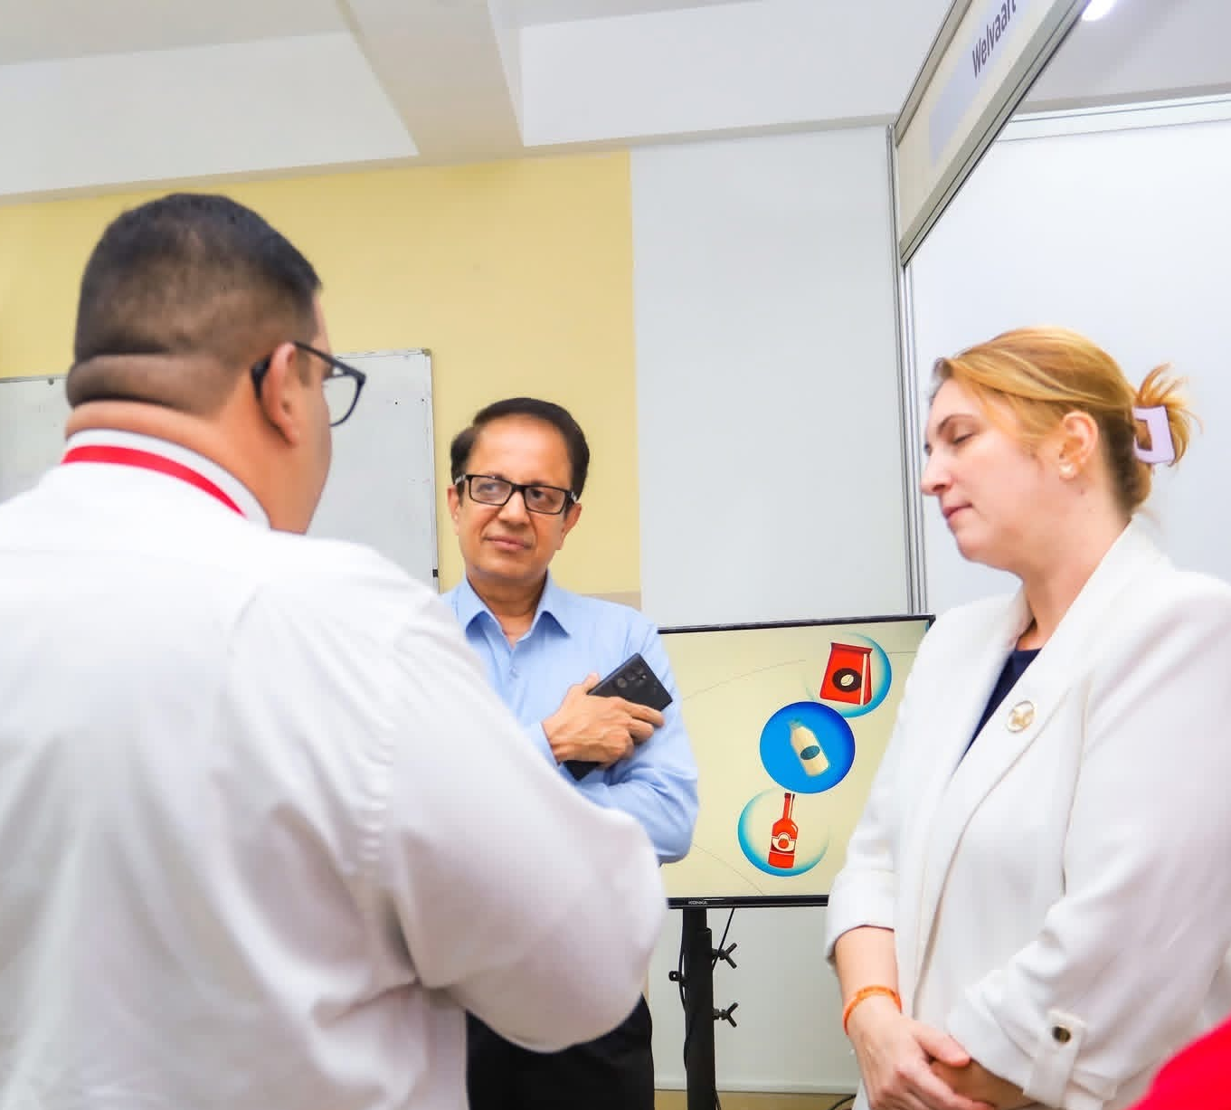
Our Team Structure & Responsibilities
TEAM LEADER
Coordination and planning of an event.
Communication with stakeholders.
Team management and encouragement.
Problem-solving and crisis management.
EVENT COORDINATOR
Cenue and vendor management.
Coordination of the timeline and schedule.
Operations and logistics.
assurance of quality.

Slide 10
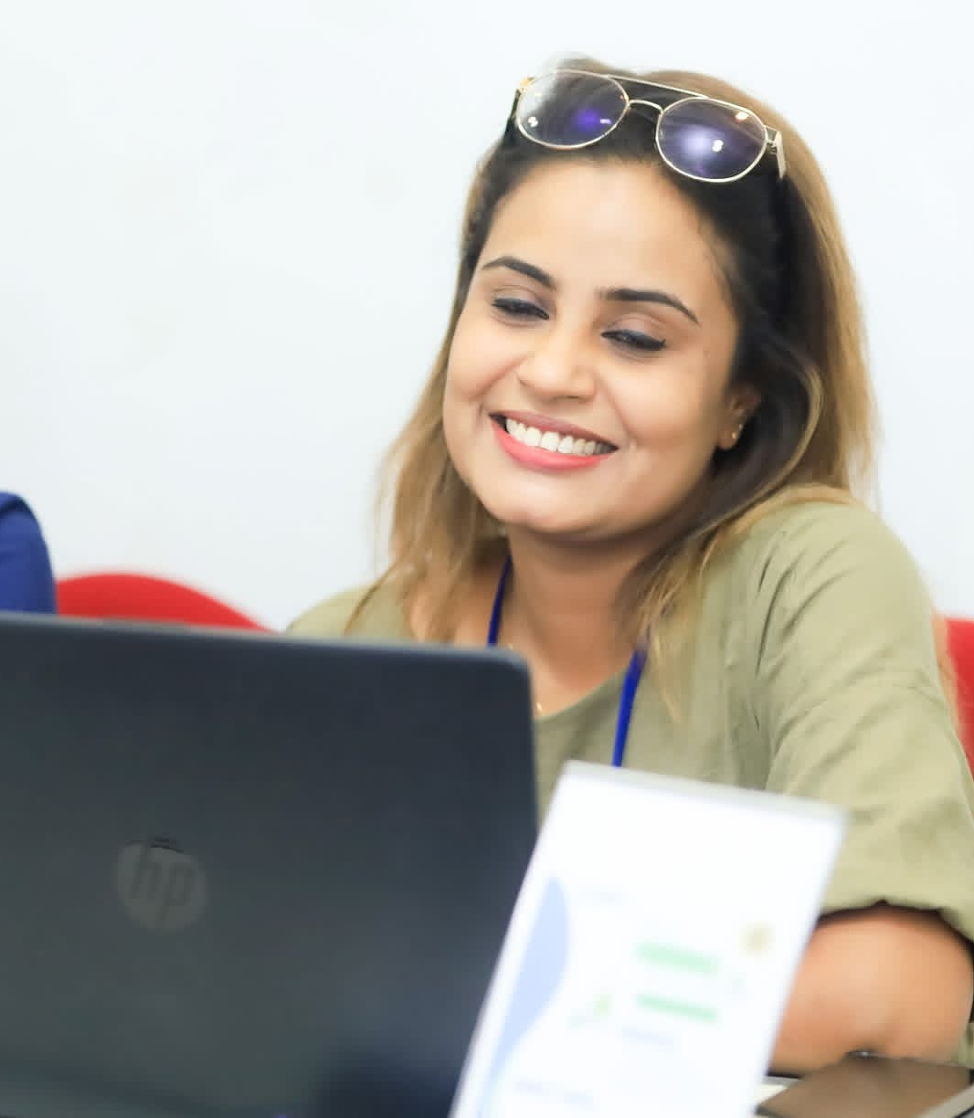
Team Expertise & Capabilities
MARKETING & OUTREACH
Promotional campaign planning
Social media management
The acquisition of sponsors and partners.
Audience engagement strategies
REGISTRATION & DATA MANAGEMENT
Systems for registering attendees.
Gathering and analyzing data.
Processing feedback.
Monitoring performance indicators.
COLLECTIVE EVENT SKILLS
Public speaking • Negotiation

Slide 11

Skills Development Journey
Skills Development Timeline:
Planning & Preparation (Weeks 1-4)
The management of stakeholders.
Setting Clear Goals.
The ability to negotiate with vendors.
Execution & Coordination (Weeks 5-8)
Managing priorities and multitasking.
Managing crises and solving problems.
Team leadership under pressure.
Evaluation & Improvement (Weeks 9-12)
Data analysis and reporting
Assessment of performance.
Planning for ongoing improvement.

Slide 12
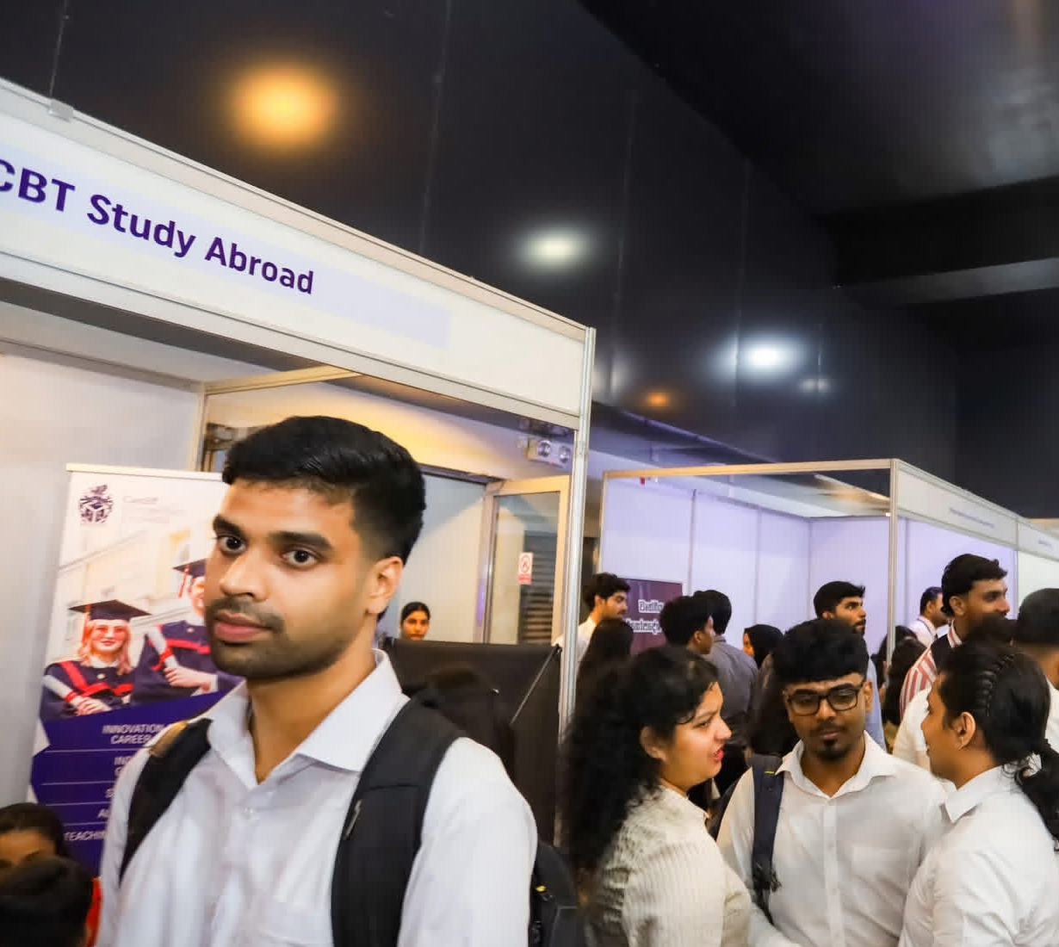
Strategic SWOT Analysis
Strengths
Event Planning
Team Coordination.
Communication.
Weaknesses
Team getting overwhelmed.
Limited Industry Connections
Opportunities
Industry Networking
Skill Development
Threats
Logistical Challenges
Attendance Uncertainty

Slide 13
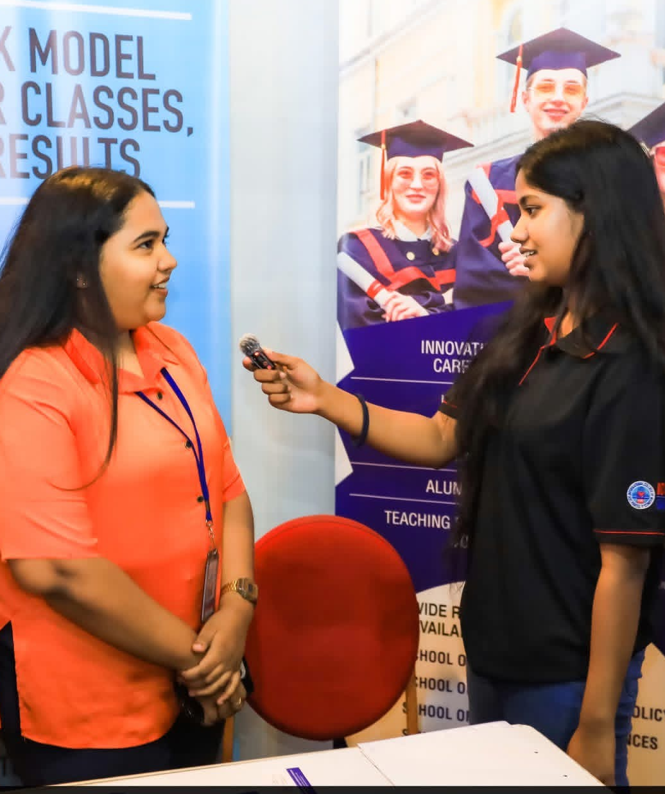
Communication Excellence
Event Communication Framework:
Stakeholder Communication:
Regular sponsor updates.
Vendor coordination meetings.
Attendee information dissemination.
Internal Team Coordination:
Progress meetings every week.
Systems for assigning tasks.
Protocols for communicating during emergencies.

Slide 14
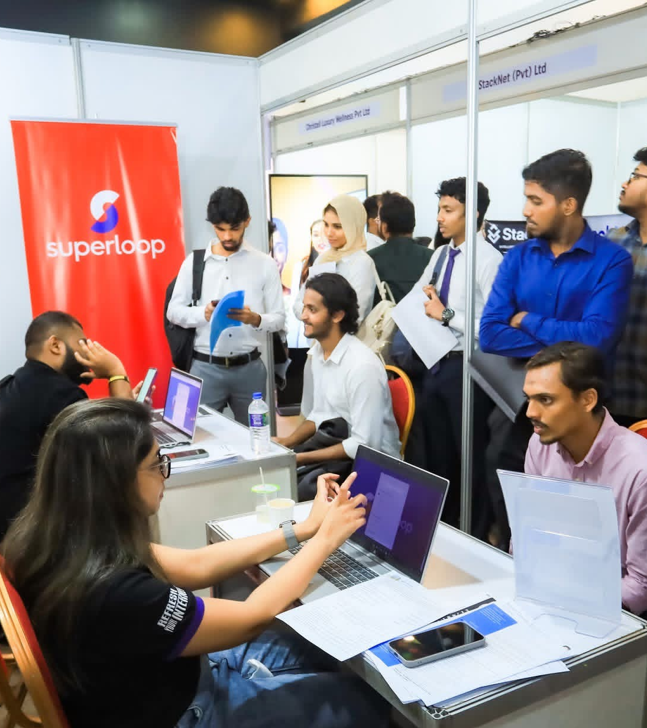
Strategic Time
Management
Event Timeline Management:
Planning Methodologies:
Analysis of the critical path.
Monitoring milestones.
Allocating time for contingencies.
Scheduling of resources.
Results Achieved:
Complete adherence to deadlines.
Effective use of resources.
The event was executed smoothly.

Slide 15
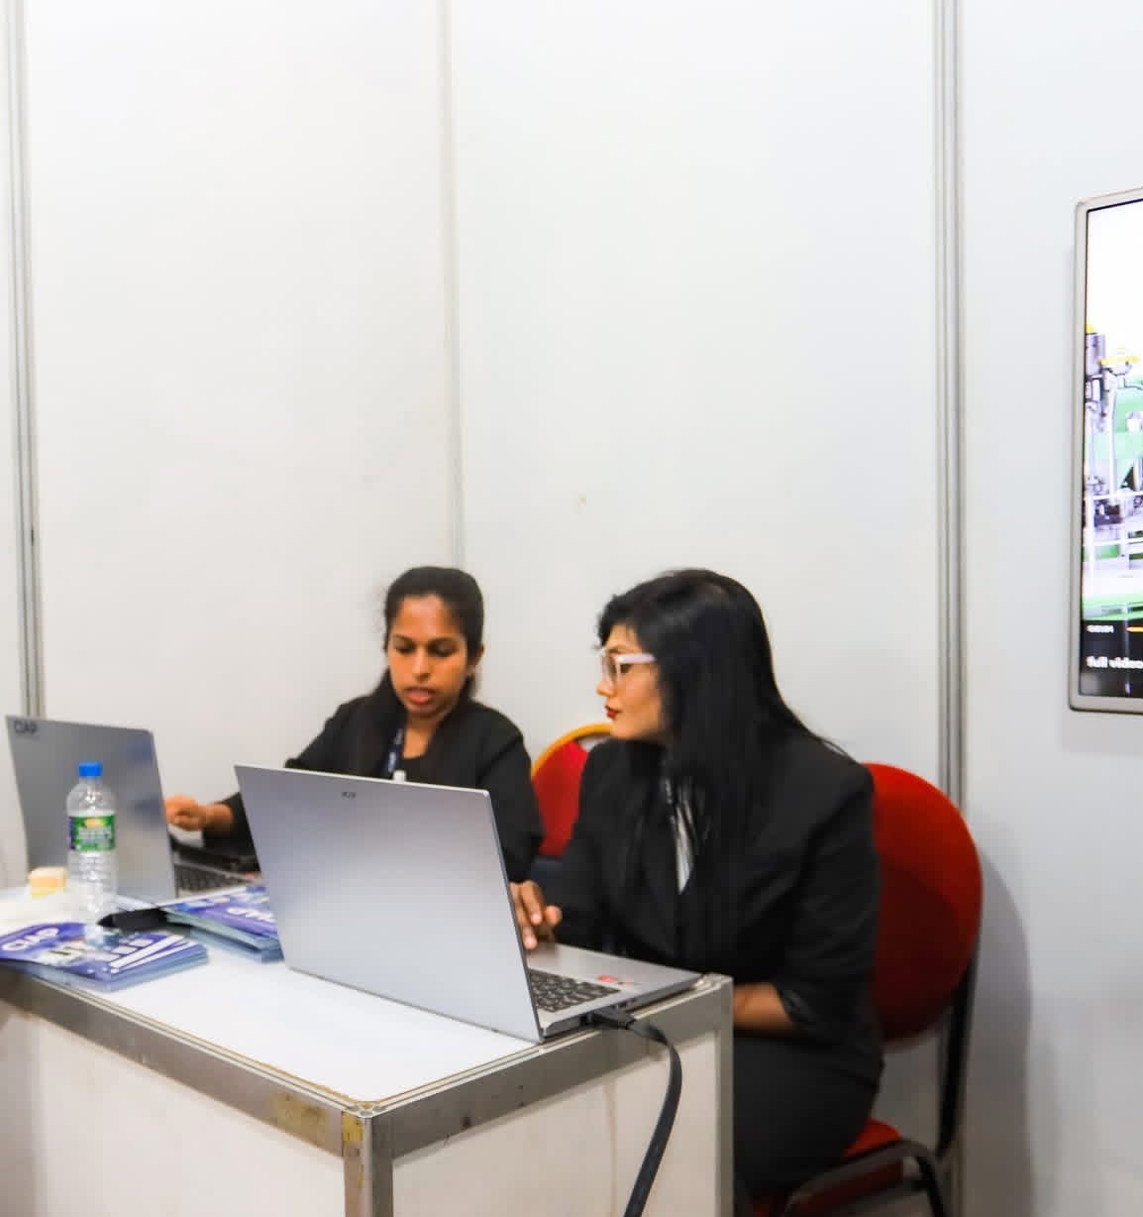
Team Collaboration
Coordination Strategies:
Cross-functional team meetings
The management of volunteers.
Coordination between departments.
Liaison with partner organizations.
Collaboration Outcomes:
Smooth teamwork.
The ability to solve problems effectively.
Integration of multiple teams is successful.

Slide 16
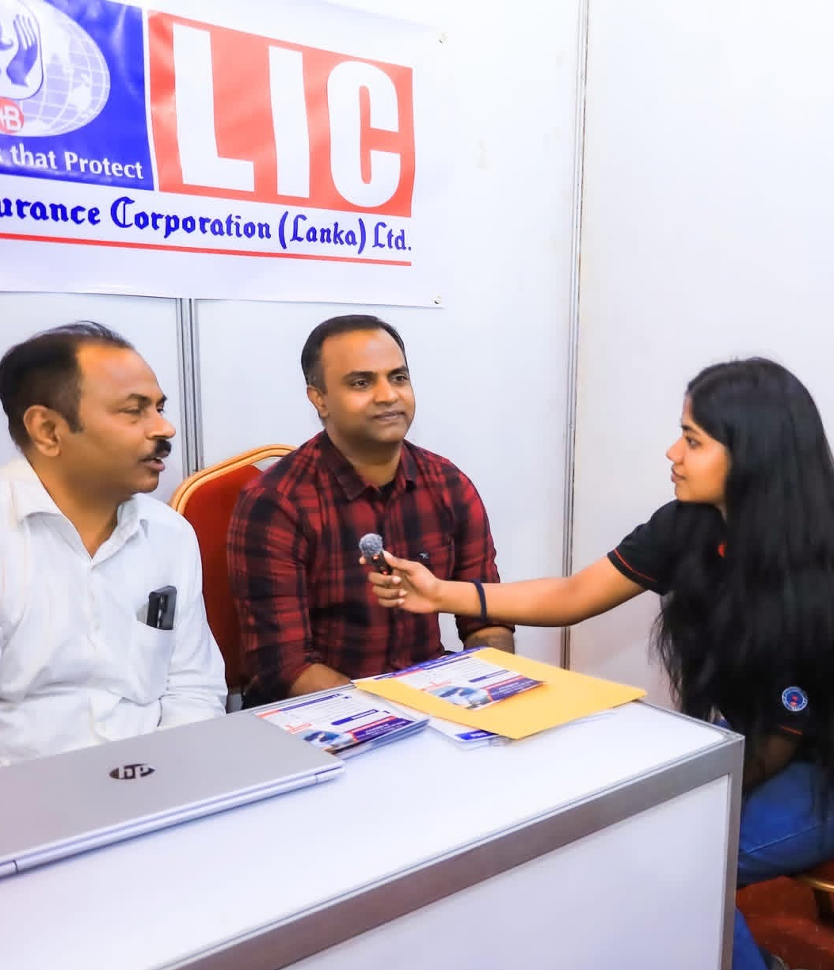
Resource Management
Internal Resources:
Team skills in planning, marketing, coordination, and communication
Time management and task distribution among team members
Use of digital tools (WhatsApp, Google Drive, shared documents)
External Resources
Venue and equipment provided by the campus at no cost
Support from sponsors through services (photography, promotion, guest speakers)
Resource Optimization
Maximum use of existing campus facilities
Efficient allocation of team member roles
Using digital processes to reduce the need for physical resources

Slide 17
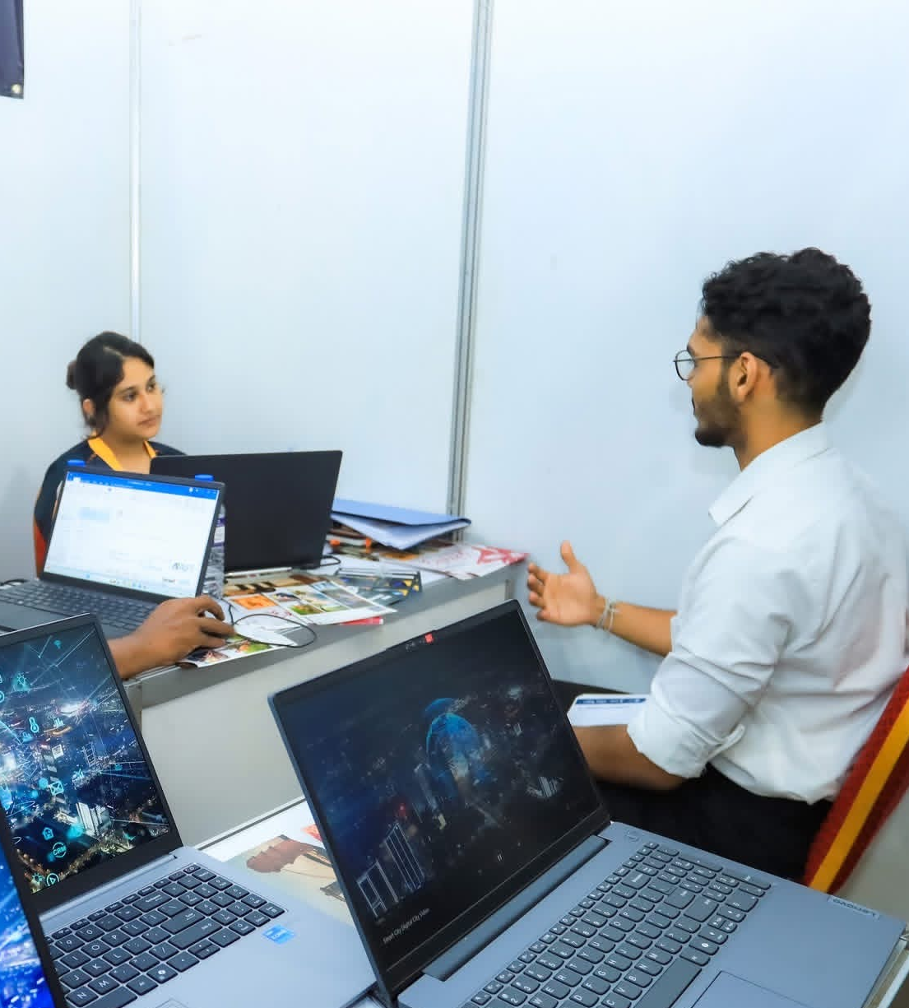
Problem-Solving Framework
Our Problem-Solving Methodology:
Step 1: Problem Identification
Analysis of the root cause.
Evaluation of the impact.
Step 2: Solution Brainstorming
Group brainstorming sessions.
The creation of alternative solutions.
Step 3: Implementation & Monitoring
The implementation of the action plan.
Ongoing assessment.
Modification and improvement.

Slide 18
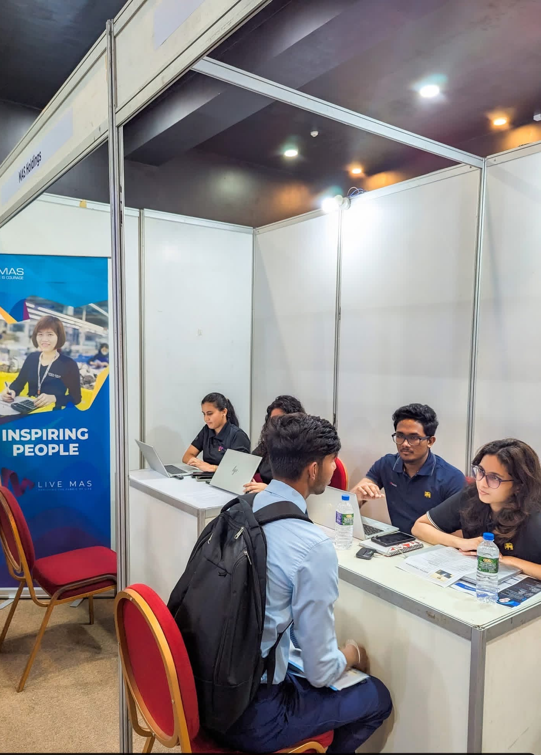
Key Achievements & Impact
Our Event Success Metrics
Event Execution Excellence:
95% of attendees are satisfied.
20% more people than expected showed up.
Complete retention of sponsors for upcoming events.
Team Performance:
40% increase in teamwork.
Successful crisis management in 3 critical situations.
Completed tasks 100% on time.

Slide 19
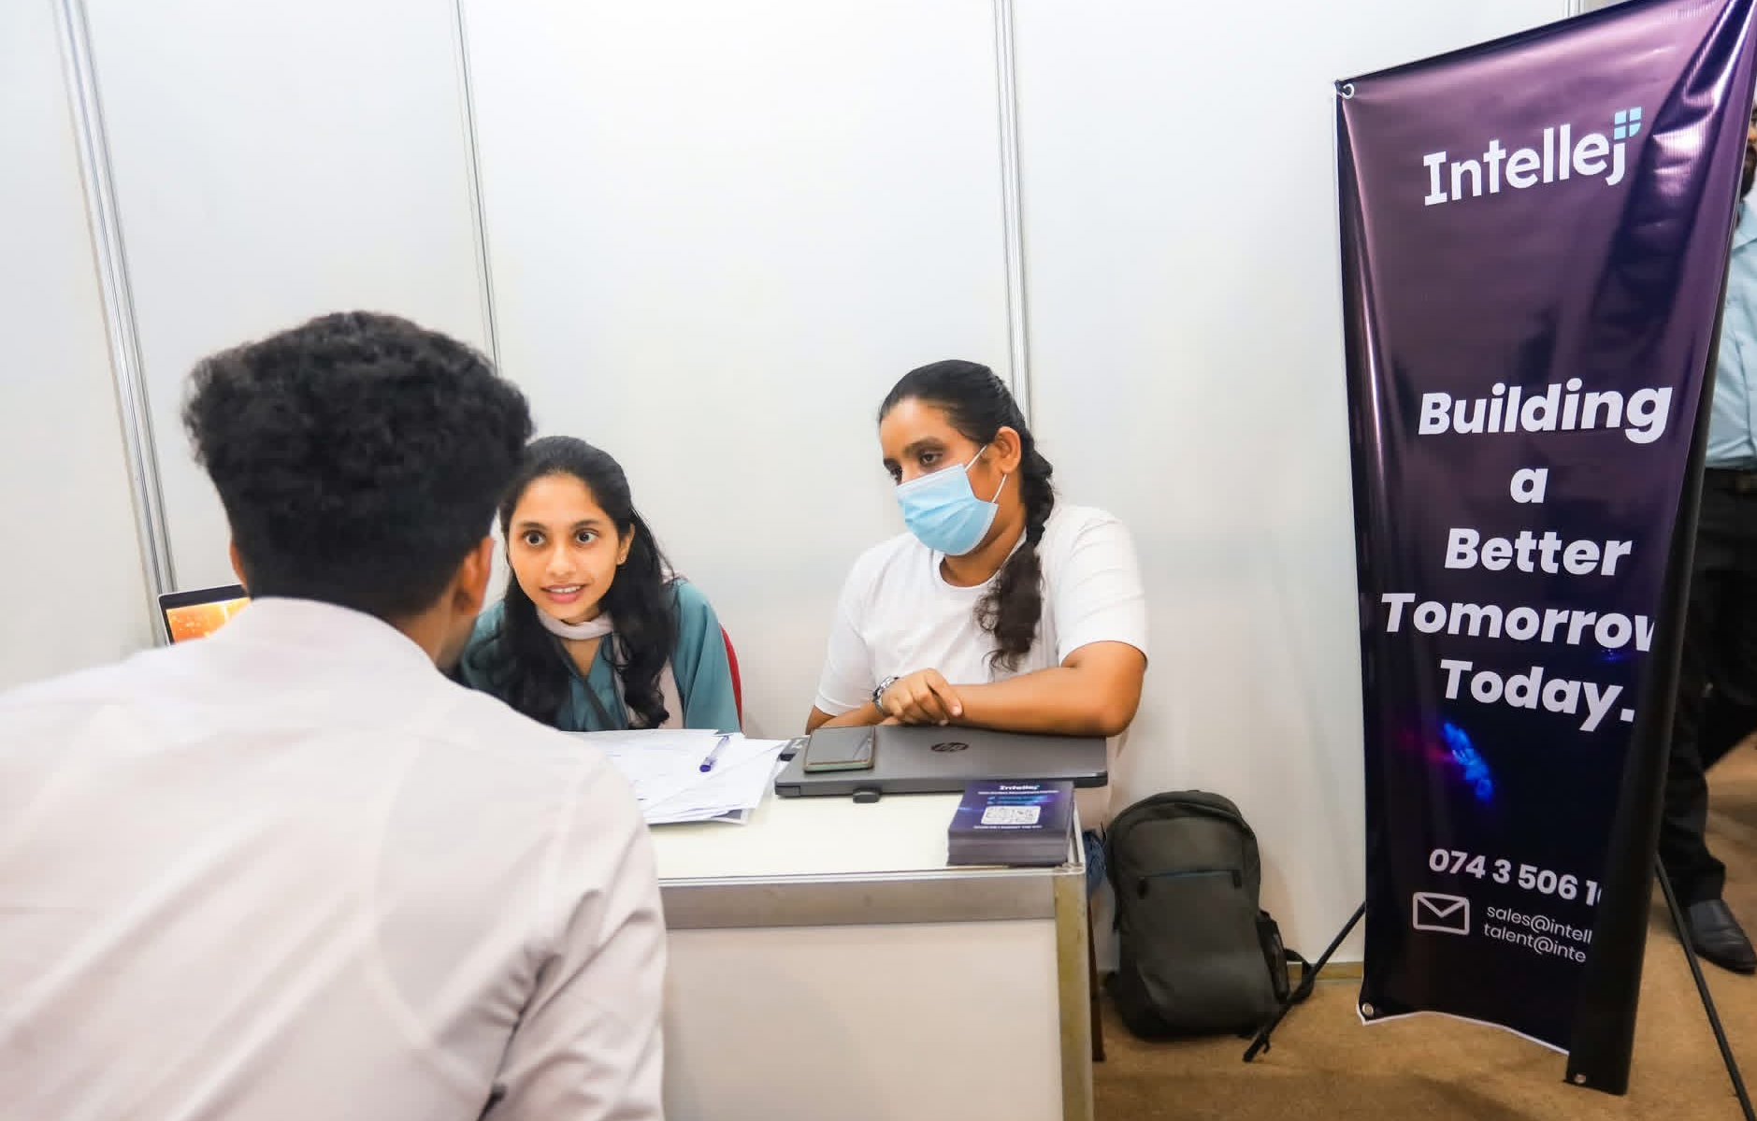
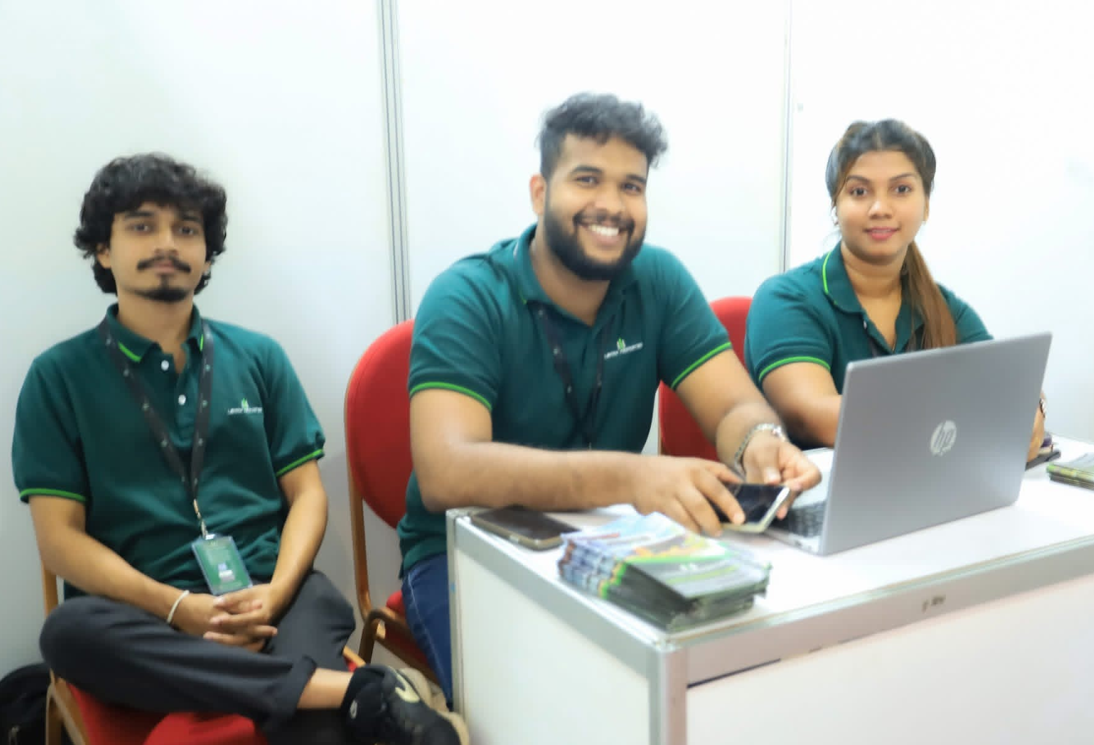
Industry Partnerships
INTELLEJ
Innovation in Software Development.
Innovative technological solutions.
Leadership in Digital Transformation.
Lavinia Properties
Real Estate Technology Advancement.
Customer-Centric Approach.
Business Development Strategies.

Slide 20
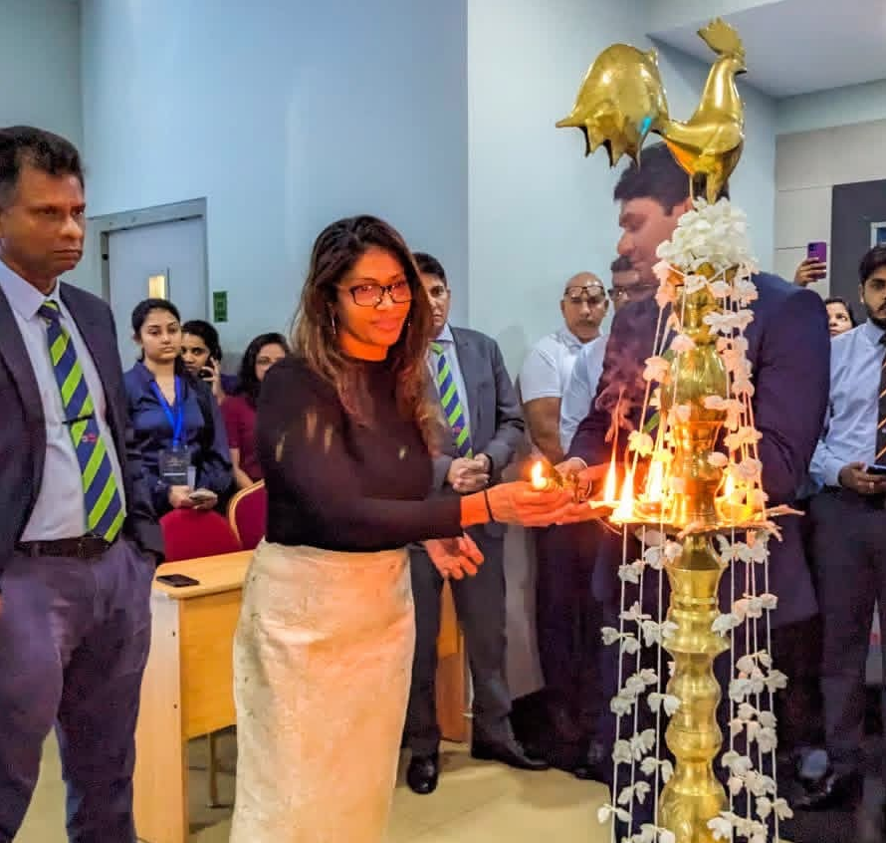
Event Management Skills Developed
Practical Skills Gained:
Project Management Skills:
Event planning and execution.
Dividing tasks among members.
Evaluation and reduction of risks.
Professional Skills:
Communication
Vendor negotiation.
Presentation and public speaking.
Soft Skills:
Crisis management
Team leadership
Adaptability

Slide 21
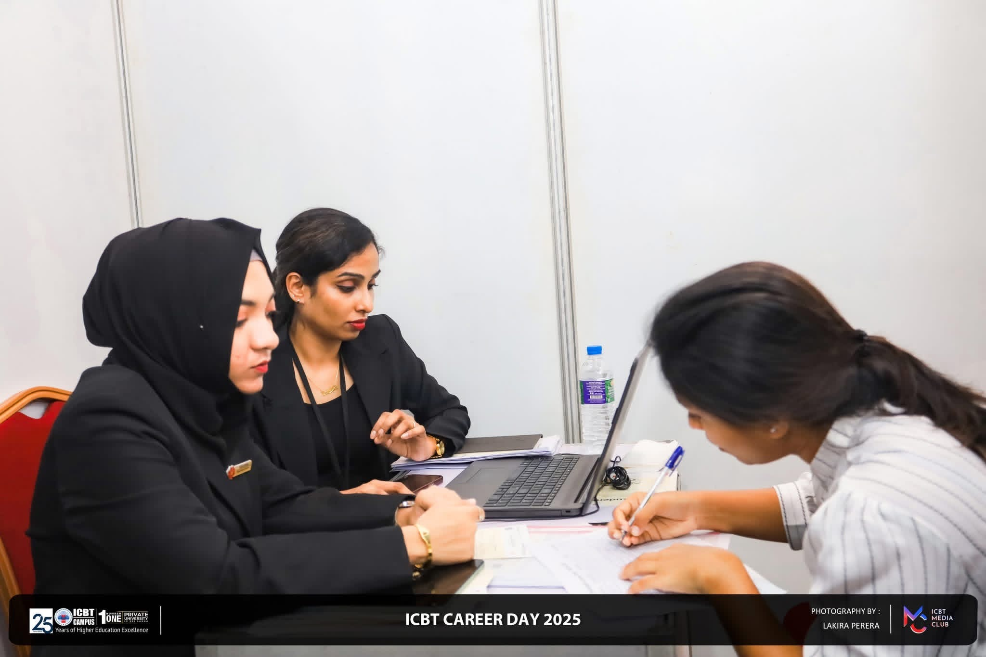
Career Ready Professionals
What We Provide:
Technical Skills Related to Industry.
Demonstrated project management expertise.
A strong attitude of collaboration.
The approach to continuous learning.
Professional Communication
Opportunities We Look for:
Jobs for Interns.
Programs for mentoring.
Real-world Project Challenges

Slide 22
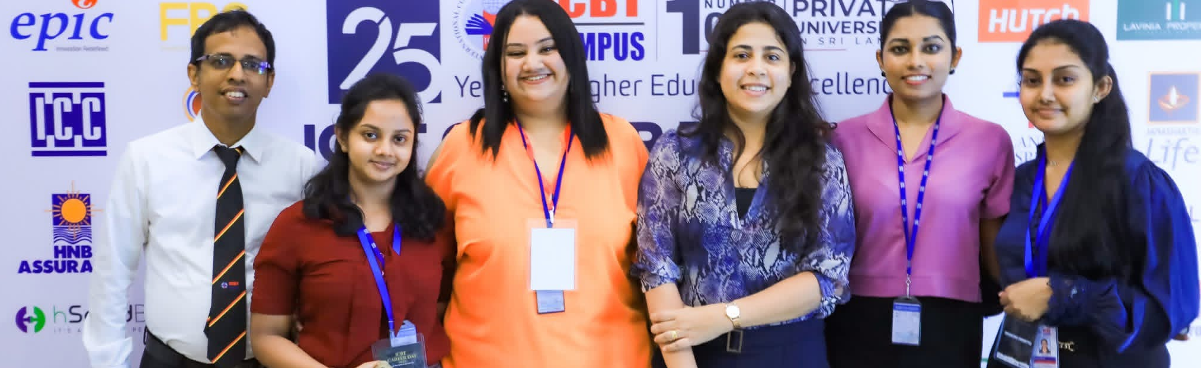
Thank you!
We're excited to discuss how our event management and project coordination skills can benefit your organization!
Thank you for your time and consideration!

Slide 23
Conclusion
Finally, the study aimed objectives have been realized using analysis, research, and systematic presentation. The results indicate the significance of the subject and its topicality in theoretical and practical generalization. This paper is a sign of careful and systematic treatment of academic work with Mr.Priyanga as the guide. The discovered insights and knowledge become valuable during the process and it is useful in further learning and in the future applications.

Slide 24
Reference
University of Cambridge. (n.d.). Research. [online] Available at: https://www.cam.ac.uk/research.
‌Dudovskiy, J. (2019). Research Methodology. [online] Research-Methodology. Available at: https://research-methodology.net/.
‌Intellej.com. (2023). Intellej [ONLINE]. [online] Available at: https://www.intellej.com/ [Accessed 16 Nov. 2025].
‌Lavinia Properties Lanka. (2024). Home – Default -. [online] Available at: https://laviniapropertieslanka.com/ [Accessed 16 Nov. 2025].
Kerzner, H. (2017). Project management: a Systems Approach to planning, scheduling, and Controlling (12th ed.). John Wiley & Sons, Inc.
‌Guffey, M.E. and Loewy, D. (2023). Essentials of business communication. 12th ed. Boston, Ma: Cengage Learning, Inc.
‌Allen, J. (2019). Event planning : the ultimate guide to successful meetings, corporate events, fundraising galas, conferences, conventions, incentives and other special events. 2nd ed. Mississauga, Ont.: J. Wiley & Sons Canada.

